Slide 1
Line of Business: User Interface
29 August 2011
Notes:
Line of Business: User Interface - <number>
Guidewire training materials contain Guidewire proprietary information that is subject to confidentiality and non-disclosure agreements. You agree to use the information in this manual solely for the purpose of training to implement Guidewire software solutions. You also agree not to disclose the information in this manual to third parties or copy this manual without prior written consent from Guidewire. Guidewire training may be given only by Guidewire employees or certified Guidewire partners under the appropriate agreement with Guidewire.

Slide 2
Lesson objectives
By the end of this lesson, you should be able to:
  Discuss the potential impact of LOB configurations on the user interface
  Configure exposure types
  Configure "new exposure" action menu behaviors
  This lesson uses the notes section for additional explanation and information.
  To view the notes in PowerPoint, choose View→Normal or View→Notes Page.
  If you choose to print the notes for the lesson, be sure to select “Print hidden slides.”
Notes:
Line of Business: User Interface - <number>

Slide 3
Lesson outline
LOB model and the user interface
Configuring exposure types
Configuring new exposure menu behavior
Notes:
Line of Business: User Interface - <number>

Slide 4
LOB model changes that impact the user interface
ClaimCenter has sets of detail views, list views, and screens which are tied to certain lists in LOB model
  When you create new entry in that list, you typically also have to create new UI containers
Other lists in the LOB model are rendered only as individual field values, menu items, or rows in list views
  New entries in these lists do not inherently require UI configuration
LossType
LOBCode
PolicyType
CoverageType
CoverageSubtype
ExposureType
Notes:
Line of Business: User Interface - <number>

Slide 5
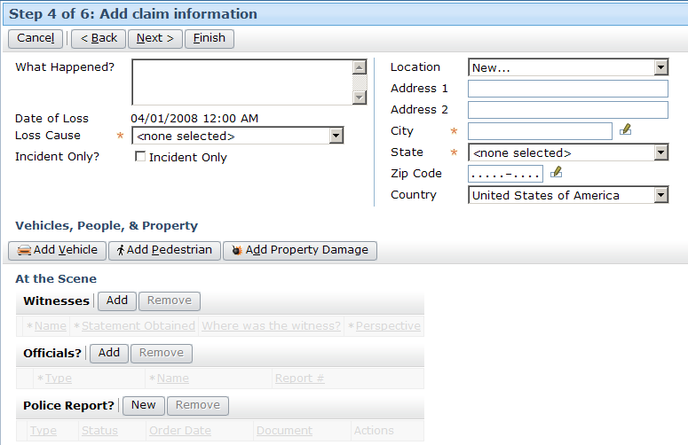
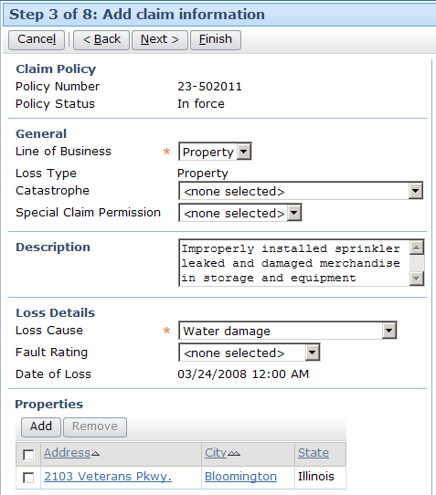
LossType UI elements
Loss type: auto
Loss type: property
Loss types are basis for screens and their sub-elements in New Claim Wizard and Claim location group
Notes:
Line of Business: User Interface - <number>

Slide 6
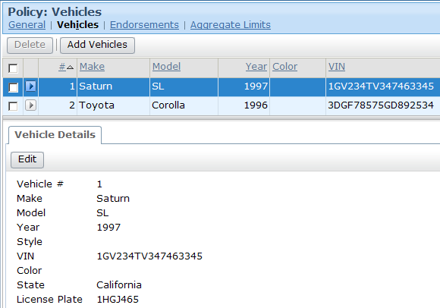
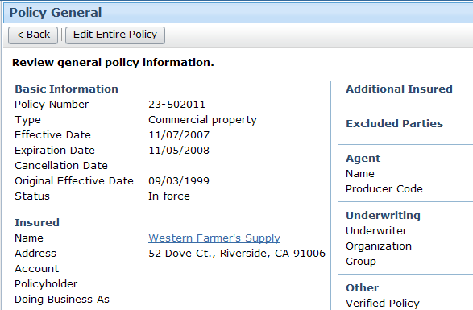
PolicyType UI elements
Policy type:
personal auto
Policy type:
commercial property
Policy types are basis for screens that display policy information
Notes:
Line of Business: User Interface - <number>
Starting with ClaimCenter 6.0, PolicyType also plays a role in the New Claim Wizard screen selection. For example, Homeowners claims have a different wizard screen than the one shown in the previous screen for Property, which still appears for Commercial Property claims.

Slide 7
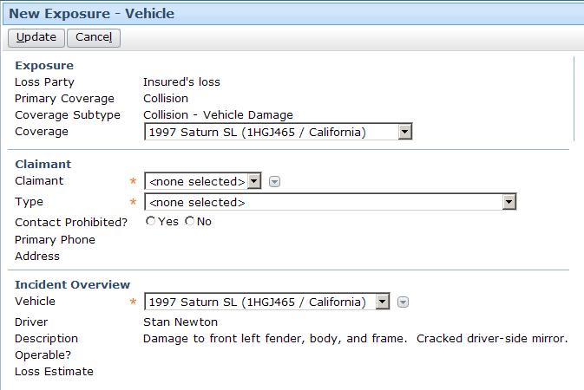
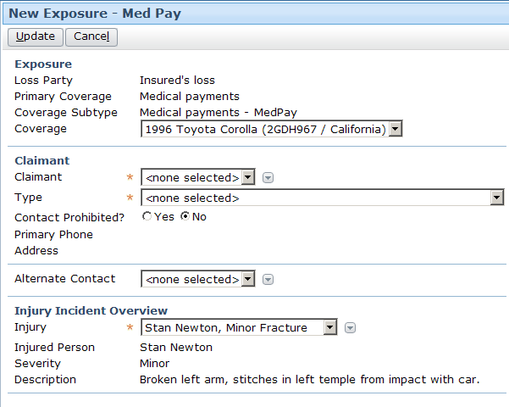
ExposureType UI elements
Exposure type: vehicle
Exposure type: med pay
Exposure types are basis for screens that create new exposures and display existing exposures
Notes:
Line of Business: User Interface - <number>

Slide 8
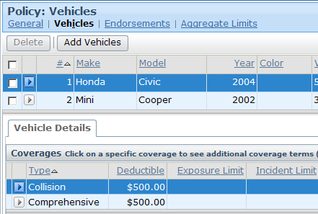
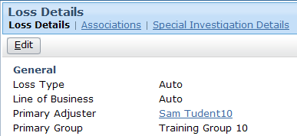

LOB model lists with no UI impact
LOB codes, coverage types, and coverage subtypes display in user interface, but typically not in a way that requires UI configuration
coverage subtypes
Notes:
Line of Business: User Interface - <number>
In the examples shown above:
LOBCode values are displayed simply as a field on existing Loss Details screens. New LOB codes simply display in the existing field.
CoverageType values are displayed in the Policy screens. New coverage type codes simply display in the existing lists.
CoverageSubtype values are displayed in menus. New coverage subtype codes simply display in the existing menus.

Slide 9
Lesson outline
LOB model and the user interface
Configuring exposure types
Configuring new exposure menu behavior
Notes:
Line of Business: User Interface - <number>

Slide 10
Exposure types
Coverages that cover damaged vehicles
collision
comprehensive
Vehicle ExposureType
liability - property damage
An exposure type is a set of information gathered about a loss pertaining to one coverage within a set of related coverages
Each exposure type is associated to:
  Incident entity or one of its subtypes
  Four required detail views
Notes:
Line of Business: User Interface - <number>

Slide 11


Exposures and incidents
New
Collision/Ray Newton
Exposure
Vehicle ExposureType
New
Vehicle Incident
Recall that incident is an item that suffers damage or loss
Every exposure is associated to one incident
  One purpose of exposure type is to identify incident
Whenever new exposure is created, new incident must also be created and initialized
Notes:
Line of Business: User Interface - <number>

Slide 12
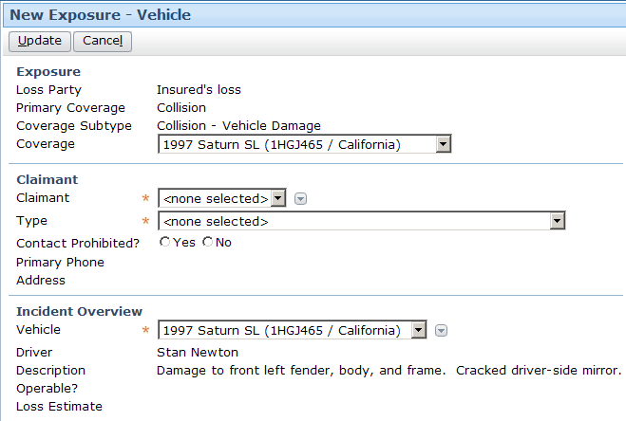
Exposures and incidents: example
Vehicle ExposureType
Collision/Ray Newton
Exposure
Ray Newton
Claimant
Vehicle
Incident
Notes:
Line of Business: User Interface - <number>

Slide 13
Exposure – incident relationship
Incident entity has several levels of subtypes
Every exposure type maps to Incident or one of its subtypes
  Identifies type of incident to create when new exposure is created
Notes:
Line of Business: User Interface - <number>
The following two slides present the incident subtype hierarchy and the exposure-incident mapping in the base ClaimCenter application.

Slide 14
The incident subtype hierarchy
Incident
InjuryIncident
PropertyIncident
TripIncident
MobileProperty Incident
FixedProperty Incident
LivingExpenses Incident
BaggageIncident
DwellingIncident
PropertyContents Incident
OtherStructure Incident
VehicleIncident
Notes:
Line of Business: User Interface - <number>

Slide 15
Base application mappings
(Exposure-Incident)
Employer
Liability
General
PIP
Med Pay
Time Loss
Incident
Loss Of Use
Trip Cancellation or Delay
InjuryIncident
PropertyIncident
TripIncident
Bodily Injury
Medical Details
MobileProperty Incident
FixedProperty Incident
LivingExpenses Incident
Living Expenses
Personal
Property
BaggageIncident
DwellingIncident
PropertyContents Incident
OtherStructure Incident
Dwelling
Baggage
VehicleIncident
Other Structure
Content
Towing
and Labor
Vehicle
Property
Notes:
Line of Business: User Interface - <number>
Every exposure type is linked to Incident or one of its subtypes. This link is required because every exposure has one underlying incident. When a new exposure is created, ClaimCenter needs to either link to an existing incident, or create and initialize a new incident. The link between ExposureType and Incident identifies the type of incident to link to (or create and initialize.)
The diagram above shows all of the exposure types in the base application.

Slide 16
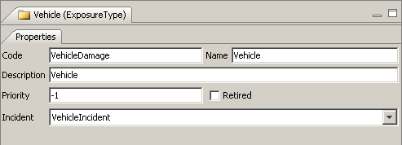
Specifying exposure type's incident subtype
VehicleIncident
...
Vehicle
In LOB Editor, ExposureType typecodes have additional Incident dropdown to specify corresponding incident subtype
  No other LOB typecodes have this field
Notes:
Line of Business: User Interface - <number>

Slide 17
Exposure detail views required for each exposure type
Creating new exposure...
...within the New Claim Wizard
  NewClaimExposureDV.ExposureType
...on an existing claim
  NewExposureDV.ExposureType
Viewing existing exposure
...on existing claim
  ExposureDetailDV.ExposureType
...in FNOL snapshot
  ClaimSnapshotExposure700DV.ExposureType
Notes:
Line of Business: User Interface - <number>
An exposure in the FNOL snapshot existed when the exposure was first created. This could be either an exposure imported from an FNOL application or an exposure created during the New Claim Wizard.
The "700" in ClaimSnapshotExposure700DV stands for 7.0, the version of ClaimCenter when the snapshot was taken. For the FNOL snapshot screens, there are also a set of:
600 forms (for claims created on an instance of ClaimCenter 6.0 but viewed in ClaimCenter 7.0)
500 forms (for claims created on an instance of ClaimCenter 5.0 but viewed in ClaimCenter 7.0)
400 forms (for claims created on an instance of ClaimCenter 4.0 but viewed in ClaimCenter 7.0)
310 forms (for claims created on an instance of ClaimCenter 3.1 but viewed in ClaimCenter 7.0)
300 forms (for claims created on an instance of ClaimCenter 3.0 but viewed in ClaimCenter 7.0)

Slide 18
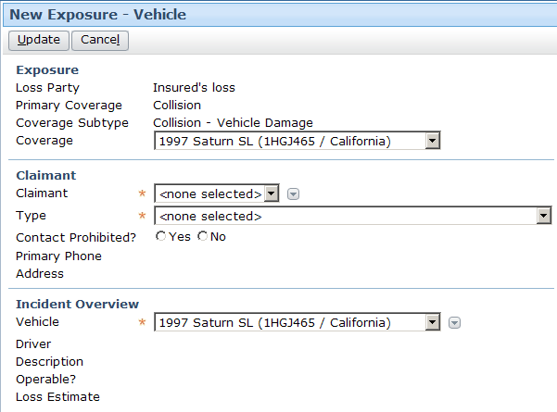
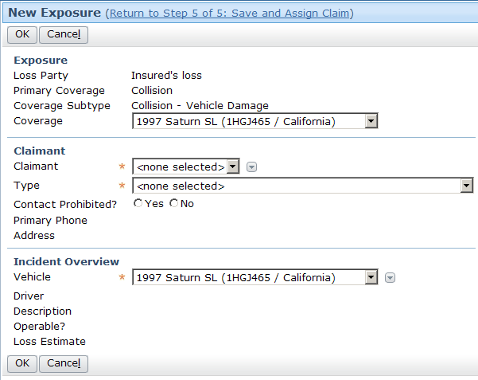
Detail views for new exposures
NewExposureDV.Vehicledamage
NewClaimExposureDV.Vehicledamage
Notes:
Line of Business: User Interface - <number>

Slide 19
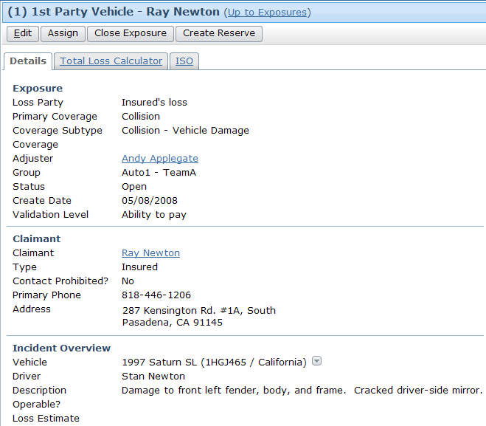
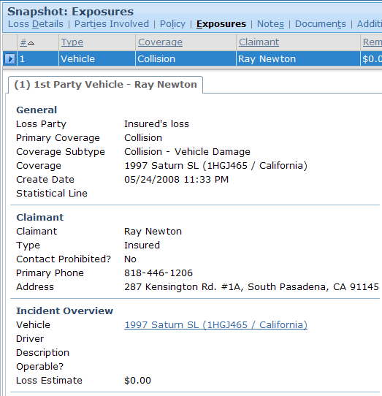
Detail views for existing exposures
ExposureDetailDV.Vehicledamage
ClaimSnapshotExposure700DV.Vehicledamage
Notes:
Line of Business: User Interface - <number>

Slide 20
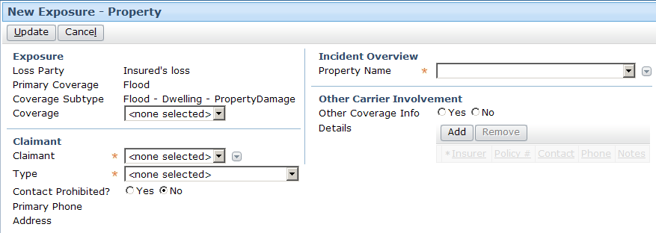
Initializing the incident
???
When new exposure is created, associated incident can be:
  New, empty incident of associated incident subtype
  Existing incident associated to claim
Notes:
Line of Business: User Interface - <number>
Typically, if a claim has existing and relevant incidents when an exposure is created, you want the initialization logic to select one of these incidents. This reduces the amount of effort expended by the end user and avoids possible duplication of data. A new, empty incident should be created only when there is no appropriate existing incident to assign the exposure to.

Slide 21
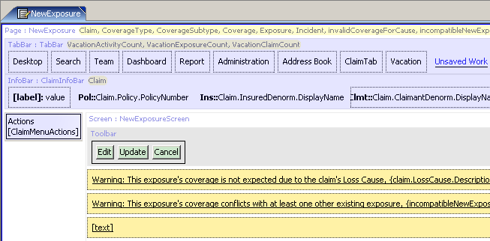
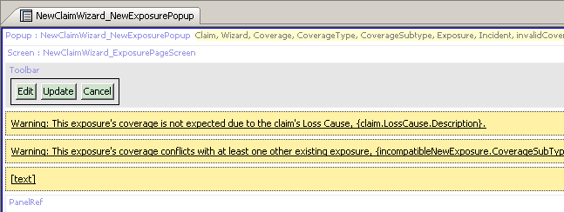
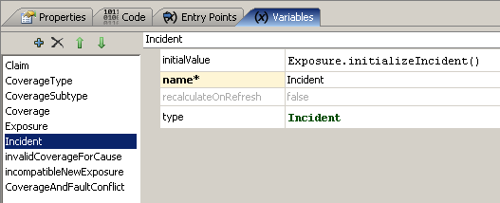
Location-level incident initialization
Locations that create exposures identify logic for initializing incidents
Notes:
Line of Business: User Interface - <number>
Whenever a new exposure is created, an incident must also be created and initialized. This initialization is done by the PCF location that creates the exposure.
In the base application, there are two locations which create new exposures: the NewExposure page (which maps to NewExposureDV) and the NewClaimWizard_NewExposurePopup popup (which maps to NewClaimExposureDV). In both cases, the locations have an Incident variable which is initialized through the Exposure's initializeIncident() method. This method finds the best incident available for the exposure and then creates a new incident.
If you create new incident subtypes which behave in a manner significantly different enough than those in the base application, then it may be necessary to update this function. The function is located in Studio in the Classes | Libraries | ExposureUI package.

Slide 22
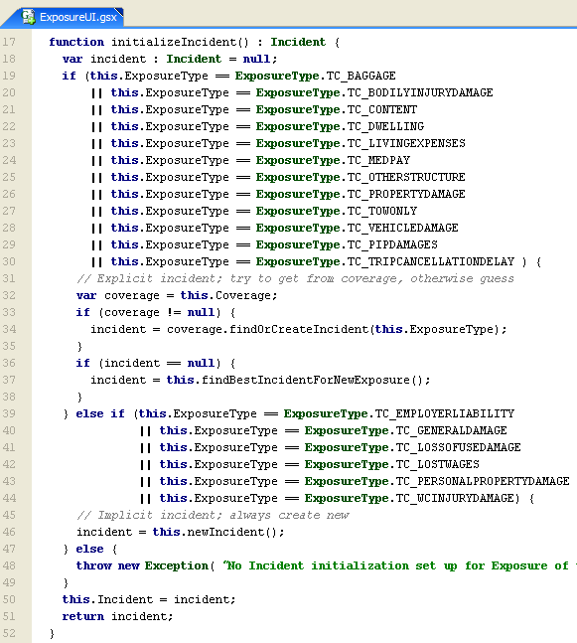
Incident initialization function
Recall that call to initializeIncident occurs in the location PCF in variable's initialValue attribute
Notes:
Line of Business: User Interface - <number>
In the base application, there are two locations which create new exposures: the NewExposure page (which maps to NewExposureDV) and the NewClaimWizard_NewExposurePopup popup (which maps to NewClaimExposureDV). In both cases, the locations have an Incident variable which is initialized through the Exposure's initializeIncident() method. This method finds the best incident available for the exposure or creates a new incident if a suitable one does not exist.
initializeIncident
Line 18 creates an incident variable of type Incident, which is set to null.
Lines 19 through 30 check to see if the exposure type is one that would require a specific type of incident. If it is, the exposure's coverage is stored in a variable called coverage. If the coverage is not null, the incident variable is set to the results of the findOrCreateIncident method. (See below.) If the coverage is null, then the incident variable is set to the results of the findBestIncidentForNewExposure method. (See below.)
If the exposure type is one that requires a generic "implicit" incident, then a new generic incident is created.
Finally, on line 51, the initialized incident is returned.
findOrCreateIncident
This method is an internal ClaimCenter method which returns an incident. If the coverage is related to a particular vehicle or property, then this method gets the associated vehicle or fixed property incident. If there is no such incident, then the method creates a new one. If the coverage is not related to a particular vehicle or property, or if it is part of a policy that is not attached to a claim, then it returns null.
(continued)

Slide 23

(Notes only slide)
Notes:
Line of Business: User Interface - <number>
findBestIncidentForNewExposure
This method is exposed in Studio in the Classes | Libraries | ExposureUI package.
This method makes use of one array and two additional methods.
PossibleIncidents
Returns all incidents on this claim's exposure that could possibly be suitable for this exposure. Only incidents whose type matches the incident type configured for this exposure (see com.guidewire.cc.domain.claim.BusinessLineConfiguration.getIncidentTypeForExposureType) are returned.
isSuitableForExposure
Used by the exposure findBestIncidentForNewExposure method to determine if a particular incident is suitable for the given new exposure. This method is only ever called with an exposure whose type matches the incident's type, so it doesn't need to check the incident and exposure type. It's job is to check any additional constraints on the incident.
function isSuitableForExposure(exposure : Exposure) : boolean
{
// Ugly to use typeis, but cannot override methods per subclass in Gosu yet
if (this typeis VehicleIncident)
{
// For a vehicle incident, the vehicle loss party must match the exposure loss party, if it
// is non null. This method is called on a new exposure so the loss party may not be set yet.
// If not, then assume the UI will set it to the first possible loss party by default
var vehicleIncident = this as VehicleIncident;
var lossParty = exposure.LossParty != null ? exposure.LossParty : exposure.PossibleLossParties[0];
return vehicleIncident.VehicleLossParty == null || vehicleIncident.VehicleLossParty == lossParty;
}
else { return true; }
}
isBetterForNewExposure( entity.Incident )
Returns whether this incident is better than the given one as the first choice for a new exposure. Default implementation checks which of the incidents is used by an exposure (unused is better) then backs off to display name ordering. The implementation can assume that the other incident provided as its argument is exactly the same subtype of incident as this incident (e.g. if this is a VehicleIncident then the "other" parameter will also be a VehicleIncident) it is permissible to throw a ClassCastException if this is not true.

Slide 24
Review: Creating new exposure types
Create ExposureType typecode (with reference to Incident or one of its subtypes)
  Complete LOB typelists editing
    Add CoverageType to link to CoverageType
      Add CoverageType, others if necessary
    Edit LossPartyType to associate with new CoverageType
Create required detail views:
  NewClaimExposureDV.ExposureType
  NewExposureDV.ExposureType
  ExposureDV.ExposureType
  ClaimSnapshotExposure700DV.ExposureType
If necessary, modify Exposure's initializeIncident() method
Notes:
Line of Business: User Interface - <number>

Slide 25
Lesson outline
LOB model and the user interface
Configuring exposure types
Configuring new exposure menu behavior
Notes:
Line of Business: User Interface - <number>

Slide 26
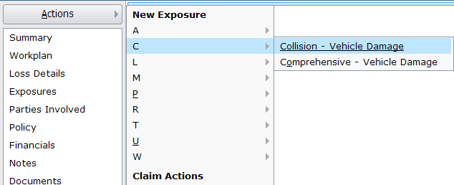
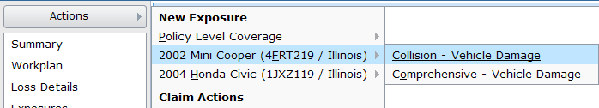
Exposure creation in config.xml
Choose by Coverage Type Menu
Choose by Coverage
Menu
For these loss types, the Choose By Coverage Type menu is displayed: {Auto, Prop, GenLiab, Travel}
  If more than {15} options are available, collapse options into first-letter submenus.
For these loss types, the Choose By Coverage menu is displayed: {Auto, Prop, GenLiab, Travel}
Notes:
Line of Business: User Interface - <number>
config.xml has a number of parameters whose behavior is connected to exposure creation.
One of the parameters is the choice of the "Choose by Coverage" menus and "Choose by Coverage Type" menus. Both menus are used to create new exposures manually, and both are enabled for the auto, property, and general liability loss types in the base application.
The "Choose by Coverage Type" menu is an alphabetic listing of all coverages associated to the claim's policy's type. If there are 15 coverages or fewer, then the coverages are listed immediately under the New Exposure header. If there are more than 15 coverages, then each coverage option is listed in a submenu according to the first letter of the coverage subtype. (In the example shown above, the "Collision - Vehicle Damage" and "Comprehensive - Vehicle Damage" coverages are listed under the "C" menu.) The threshold number at which coverages are collapsed into "first letter" submenus is also controlled by a parameter. This set of menus list all coverages, whether they are actually on the policy or not.
The "Choose by Coverage" menu is a set of menus, one for each "risk unit" on the policy (such as the vehicles for an auto policy). There is also a "Policy Level Coverage" menu. Within each of these menus is a submenu of the appropriate coverages.
For a given line of business, a given instance of ClaimCenter can use the "Choose by Coverage Type" menus, "Choose by Coverage" menus, or both. The method can vary across loss types. (For example, the auto loss type could use "Choose by Coverage" menus and the property loss type could use "Choose by Coverage Type" menus.)
Typically, exposures in a workers' comp claim are created automatically during claim setup and are not created manually. Therefore, the "WC" loss type is typically not listed for either option.
Some exposure creation parameters in config.xml have been omitted from the list above. For the complete list, consult the config.xml file itself.

Slide 27
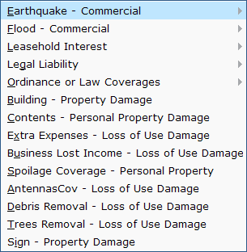





Coverage subtype menu behavior
coverages
coverage subtypes
In exposure creation menus, both coverages and coverage subtypes can be listed in the same menu
  This occurs when a coverage maps to multiple subtypes
Notes:
Line of Business: User Interface - <number>
In the menu on the left, the list includes both coverages and coverage subtypes. "Earthquake - Commercial", "Flood - Commercial", "Leasehold Interest", "Legal Liability", and "Ordinance or Law Coverages" are all coverages with multiple coverage subtypes. Therefore, the coverage subtypes are collapsed into a child menu, and the coverage is used as the label to access the child menu. All of the menu items starting with and below "Building - Property Damage" and all the menu items in the child menus reference coverage subtypes.

Slide 28
Lesson objectives review
You should now be able to:
  Discuss the potential impact of LOB configurations on the user interface
  Configure exposure types
  Configure "new exposure" action menu behaviors
Notes:
Line of Business: User Interface - <number>

Slide 29
Review questions
If new typecodes are added to all 6 levels of the LOB Model, which three levels will typically require additional UI configuration outside of base?
  LossType
  LOBCode
  PolicyType
In the LOB Editor, ExposureType typecodes have an extra dropdown. What does this dropdown specify?
When you create a new exposure, what other type of object (either creating new or using an existing one) must be associated to the exposure ?
There are four detail views required for each exposure type. Under what circumstance is each detail view used?
  CoverageType
  CoverageSubtype
  ExposureType
Notes:
Line of Business: User Interface - <number>
Answers
1. LossType, PolicyType, and ExposureType.
2. The Incident or Incident subtype related to the ExposureType
3. An incident.
4. a) Creating a new exposure in the New Claim Wizard (NewClaimExposureDV)
b) Creating a new exposure on an existing claim (NewExposureDV)
c) Viewing an exposure on an existing claim (ExposureDV)
d) Viewing an exposure in the FNOL snapshot (ClaimSnapshotExposure700DV)

Slide 30
Notices
Copyright © 2001-2011 Guidewire Software, Inc. All Rights Reserved.
Guidewire, Guidewire Software, Guidewire ClaimCenter, Guidewire PolicyCenter, Guidewire BillingCenter, Guidewire Reinsurance Management, Guidewire ContactManager, Guidewire Vendor Data Management, Guidewire Client Data Management, Guidewire InsuranceSuite, Guidewire ContactCenter, Guidewire Studio, Gosu, Deliver Insurance Your Way, and the Guidewire logo are trademarks or registered trademarks of Guidewire Software, Inc. in the United States and/or other countries.
This material is Guidewire proprietary and confidential. The contents of this material, including product architecture details and APIs, are considered confidential and are fully protected by customer licensing confidentiality agreements and signed Non-Disclosure Agreements (NDAs).
This file and the contents herein are the property of Guidewire Software, Inc. Use of this course material is restricted to students officially registered in this specific Guidewire-instructed course, or for other use expressly authorized by Guidewire. Replication or distribution of this course material in electronic, paper, or other format is prohibited without express permission from Guidewire.
    Guidewire products are protected by one or more of the following patents: U.S. Patent No. 7,885,831; U.S. Patent No. 7,788,296.
Notes:
Introduction to Guidewire Configuration - <number>

